Slide 1

Watch Video
Email: contact@codeshoppy.com
Call : +91 9629754500

Slide 2
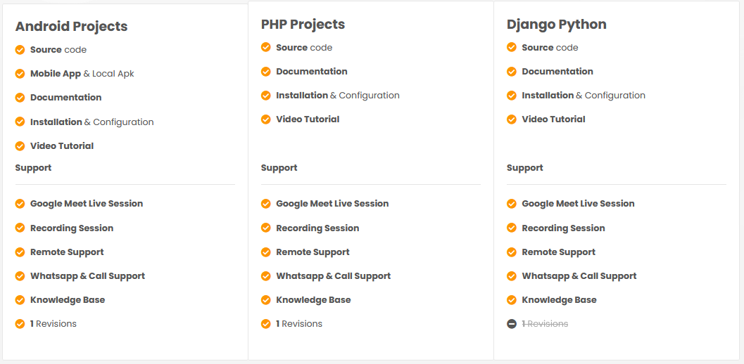

Slide 3
ONROAD VEHICLE BREAKDOWN ASSITANCE APPLICATION ( ORVBA )

Slide 4
AIM OF THE PROJECT
On Road Vehicle Breakdown Assistance (ORVBA) is going to be a good solution for the people who seek help in the remote locations with mechanical issues of their vehicle.
Users of the On Road Vehicle Breakdown Assistance will be the registered public and they be getting connected with the particular mechanic through the trustworthy On Road Vehicle Breakdown Assistance (ORVBA) system.
Because only approved mechanics are enlisted in the On Road Vehicle Breakdown Assistance (ORVBA) system.
Also they are under monitoring by the ORVBA system for not charging any extra service fee from the users as every user is updating their feedback about the availed service through ORVBA system.

Slide 5
OBJECTIVE OF THIS PROJECT
On Road Vehicle Breakdown Assistance application helps to find mechanics easily and quickly. It is difficult to find mechanics nearby area wherever you are travelling. This system helps to overcome this issue by providing mechanic details in one click.
Providing a smart technology On Road Vehicle Breakdown Assistance system.
Reducing human time and effort
This application will help to reduce wasting user time for found a proper mechanic.
The majority of the population today uses smart phones with active internet connection, which is the basic requirement for this product to function properly.
This project falls under the category of embedded systems and android applications

Slide 6

SOFTWARE AND HARDWARE REQUIREMENTS
HARDWARE REQUIREMENTS:
Processor : intel 3
Motherboard : intel 915gvsr chipset board
Ram : 4 gb ddr2 ram
Hard disk drive : 160 gb
SOFTWARE REQUIREMENTS:
Front end : html5, css3, bootstrap
Back end : php, mysql
Control end : angular java script
TOOLS:
Android Emulator
xampp-win32-5.5.19-0-VC11
Android Studio

Slide 7
EXISTING SYSTEM
In an existing system there are users who have their own mechanic database which is very minimal .
Users with the contacts of people at the particular place may look for a help from them only if they are ready to do.
It is not possible to find out the suitable mechanic for the desired service at remote locations.
The only way they have is to look for any other transportation at the time of issue and then they need to get a mechanic to the particular location at which they have left their vehicle.

Slide 8
DISADVANTAGES OF EXISTING SYSTEM
user needs to gather the mechanic related information through friends or through website.
It increases the human work and user could not easily identify the mechanic details and get help from that workshop.
Though the mechanic details provided by the mechanic may vary by its location of workshop.
User could not find the nearby location of mechanic and get help they required on time.

Slide 9
PROPOSED SYSTEM
Mobile application technology is beneficial for On Road Vehicle Breakdown Assistance .
Here the users of On Road Vehicle Breakdown Assistance (ORVBA) system can search for list of mechanic at any location or the nearby locations which will help them in an unexpected situations raised by the mechanical issues of their vehicles.

Slide 10
ADVANTAGES OF PROPOSED SYSTEM
It is one of the best applications used while emergency
Easy to use.
Provides both locations nearby needs.

Slide 11
MODULE LIST
ADMIN
Provide Approval
USER
Register
Login
View Details
Search records & call
Post feedback

Slide 12
MODULE LIST
MECHANIC
Register
Login
Post details
View feedback

Slide 13
USECASE DIAGRAMS
USER
ADMIN
MECHANIC

Slide 14
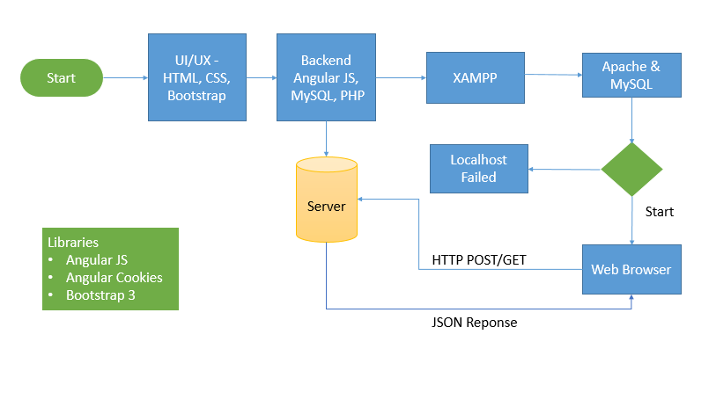
WORKFLOW DIAGRAM FOR WEB APPLICATION

Slide 15
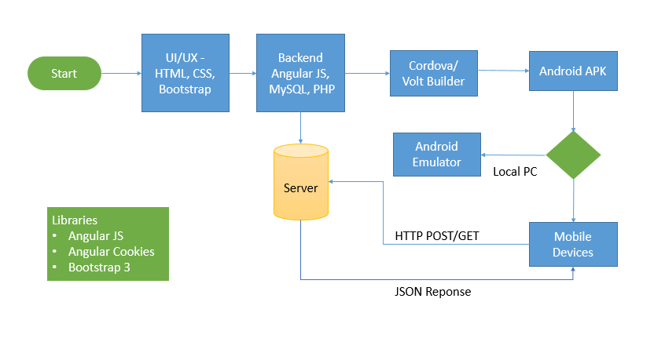
WORKFLOW DIAGRAM FOR ANDROID APPLICATION

Slide 16
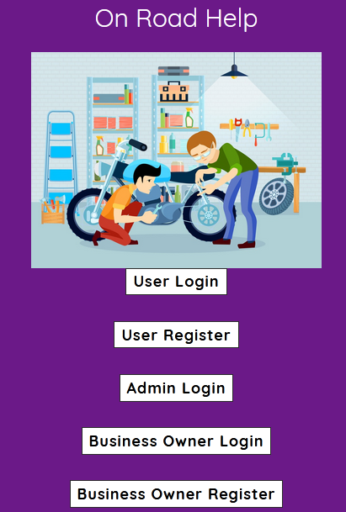
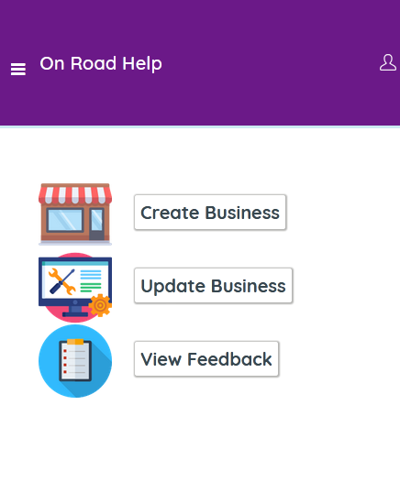
SCREENSHOTS

Slide 17
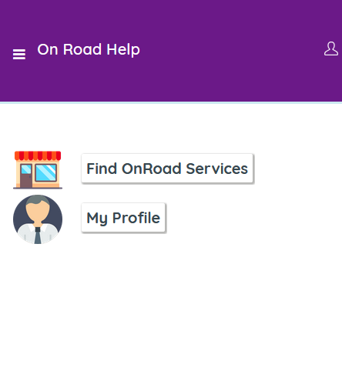

Slide 18
CONCLUSION
In conclusion, thus our emergency breaks down service give better location result.
Our application easily identifies the nearby location which is very useful to the user who uses it in emergency needs.
Our application shall make all possible efforts to locate and direct the nearest service provider to user’s location.
It help us the user for mechanical breakdown towing, fuel delivery, flare tire change and vehicle collision.

Slide 19
FUTURE ENHANCEMENT
In Future work, This application to develop a cross platforms like IOS, etc.
In adding the more features of On road fuel demand application management system to develop access with user’s flexibility.
To authenticate the users based on the system users list which is maintained by the operating system
To restrict the usage of all files by the users based on their privileges on the system

Slide 20
REFERNECES
Mi-JinKim, Jong-Wook Jang and Yun-Sik Yu, "a Study on In-Vehicle Diagnosis System using OBD-II with Navigation", IJCSNS International Journal of Computer Science and Network Security, vol. 10, no. 9, September 2010.
Javier E. Meseguer, Carlos T. Calafate, Juan Carlos Cano and Pietro Manzoni, "Driving Styles: a smartphone application to assess driver behaviour".
Min Goo Lee, Yong Kuk Park, Kyung Kwon Jung and Jun Jae Yoo, "Estimation of Fuel Consumption using In-Vehicle Parameters", International Journal of u-and e-Service Science and Technology, vol. 4, no. 4, December 2011.
M. Jyothi, Kiran and S. Ravi Teja, "Vehicle health monitoring system", International Journal of Engineering Research and pplications (IJERA), vol. 2, no. 5, September-October 2012.

